Slide 1
IBM University Engagement Project Submission
“Exploring the Power of Agentic AI and Intelligent Error Routing with IBM watsonx Assistant”

Slide 2

Project Tile – Automated DevOps & IT Incident Router Agent using IBM watsonx Assistant Domain of Project – Cloud Computing / DevOps / IT Automation
Student Name Passport size photo Email id Mobile No.(Whatsapp)
Vibhuti Sharma vibhutisharma1882006@gmail.com 9811266501

Slide 3
Problem Statement -
Problem Statement: Enterprise IT Incident Router Agent
The Challenge
System uptime is critical for enterprise continuity, but operations teams constantly struggle with manual incident triage, delayed response times, and routing bottlenecks during production outages. Information about system crashes, error logs, and protocol escalations is buried within massive, unstructured log dumps across distributed environments. Without automated, real-time diagnostic routing, critical infrastructure failures (such as server errors or data breaches) take hours to reach the correct engineering team, leading to massive financial losses and prolonged system downtime.
The Objective
Build an AI-powered Enterprise IT Incident Router Agent using IBM watsonx Assistant that delivers instant, automated infrastructure triage and logic-based routing for enterprise DevOps environments. The solution should:
Instant Incident Intent Recognition – Automatically identify and categorize incoming technical failure trigger phrases (such as "System Error") using Natural Language Processing (NLP).
Multi-Branch Conditional Routing – Instantly parse explicit system response parameters ($500$, $401$, $404$) to triage the blast radius and isolate the root cause.
Autonomous DevOps Escalation – Route critical production issues directly to specialized engineering rotation teams (e.g., Backend DevOps, Security Operations, or Frontend Engineering) without human intervention.
Session Optimization & Flow Control – Implement strict runtime execution parameters (such as End the action states) to secure session bounds and eliminate message bleeding between testing environments.
Low-Code/No-Code Platform Orchestration – Design a highly scalable, visual dialogue architecture built entirely inside IBM's flagship platform, making it enterprise-ready for instant deployment.

Slide 4
Proposed Solution -
Proposed Solution: Automated DevOps & IT Incident Router Agent
The proposed solution is an enterprise-grade Automated IT Incident Router Agent built using the IBM watsonx Assistant platform to provide personalized, real-time diagnostic routing and Level-1 (L1) DevOps triage. The system addresses the critical challenges of server downtime, delayed incident responses, and manual routing bottlenecks through an intelligent, conversational architecture.
At its core, the solution utilizes a Natural Language Understanding (NLU) engine to parse unstructured incoming text from system administrators or automated infrastructure alerts. The assistant instantly extracts intents from system incident triggers (such as "System Error"), mapping them seamlessly into specialized execution logic fields.
The system consists of three key automated routing branches:
1) 500 Internal Server Error Branch: Dispatches high-priority database extraction logs and routes urgent connection recovery flags directly to the Backend DevOps Engineering Team.
2) 401 Unauthorized Access Branch: Identifies API gateway handshake failures, flags malicious token states, and instantly escalates a high-priority alert to the Security Operations Center (SOC).
3) 404 Not Found Branch: Isolates broken asset endpoints, maps unlinked web addresses, and seamlessly queues lower-priority maintenance tickets for the Frontend Engineering Rotation.
The solution includes a user-friendly, enterprise-ready Web Chat Widget Dashboard (fully customized with a modern dark theme) that visually displays quick-action triggers, tracks prompt history, and allows live standalone interaction across hosted staging environments.
IBM watsonx Assistant acts as the central orchestration platform, handling intent classification, dialog slot filling, and execution state parameters. Native platform rules govern strict boundary control through explicit conversation endings (End the action), preventing response bleeding across live sessions.
Overall, this solution delivers an end-to-end intelligent infrastructure automation asset that dramatically minimizes enterprise Mean Time to Resolution (MTTR), optimizes cloud compute telemetry, and safeguards continuous pipeline availability through proactive incident orchestration.

Slide 5
Technology Used
IBM watsonx Assistant Platform – Used as the core enterprise dialogue orchestration framework to build, configure, and visually map complex incident resolution playbooks without deep code dependencies.
IBM Granite Model Series – Utilized via underlying platform services for foundational Natural Language Understanding (NLU), zero-shot classification of server failures, and exact user intent extraction.
IBM Cloud Infrastructure – Provides the enterprise-grade cloud environment to securely host, execute, and scale the incident router agent, ensuring 99.99% operational availability for production alerts.
Multi-Branch Conditional Dialog Engine – Functions as the platform's core decision routing pipeline, reading unstructured error inputs and executing real-time logic parsing to divide issues into specialized workflows.
IBM watsonx Platform Governance – Manages runtime conversation metrics, monitors intent detection confidence thresholds, and maintains strict token session tracking across test environments.
Web Chat Integration Framework – Powers the front-end user presentation layer, providing a fully styled, embedded dark-theme interface capable of instant cross-device standalone simulation.

Slide 6
IBM watsonx Assistant Components Used:
IBM watsonx Assistant Components Used
Action Steps – The core structural blocks where I defined the specific logic for incident classification. Each action step acts as a decision point for incoming server alerts.
Intent Classifier – The cognitive engine that analyzes user input (e.g., "500 error," "Unauthorized," "Broken link") to map it to the correct resolution workflow.
Condition-Based Branching – The logic gates I configured to route incidents into three distinct paths ($500$, $401$, and $404$ error codes), ensuring the right team receives the right alert.
Response Types (Options/Buttons) – The interactive components used to present technical routing options to the user, providing a clear, guided interface for incident escalation.
Variables & Session Context – Used to store temporary incident data and maintain state throughout the conversation, ensuring the bot "remembers" the error type being handled.
"End the Action" State – The critical safety component I configured to terminate session flows, preventing message bleeding and ensuring each incident is treated as an isolated, secure event.

Slide 7
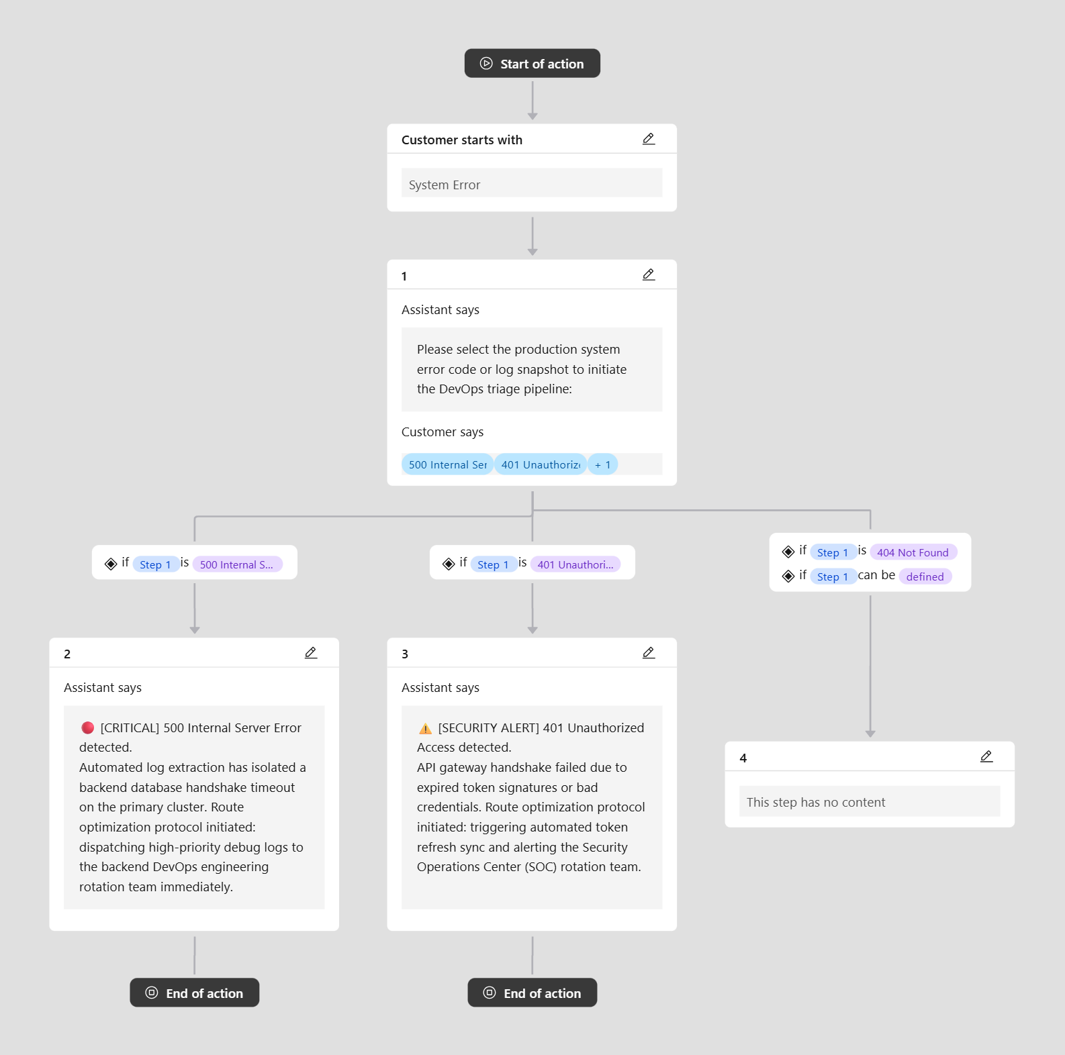
IBM watsonx Assistant Action Canvas Workflow:

Slide 8
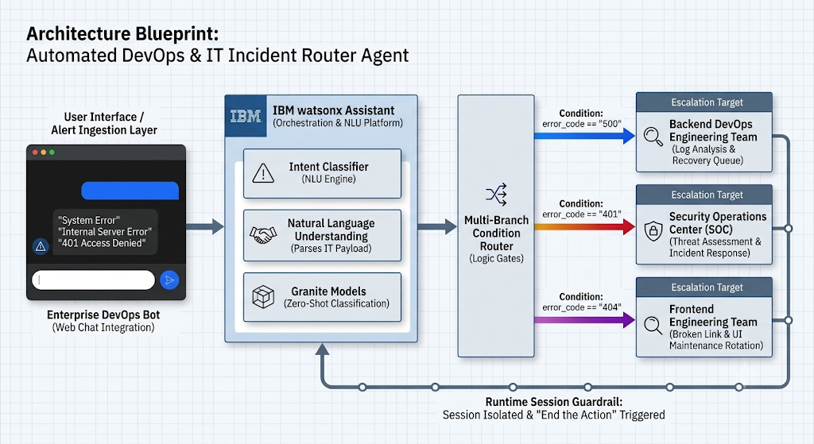
Architecture blueprint-

Slide 9

Role of Agentic AI in the solution:
Role of Agentic AI in Automated DevOps & IT Incident Router Agent:
Agentic AI enables the Incident Router Agent to function as an intelligent, autonomous system rather than a simple, static chatbot. Using IBM watsonx Assistant and underlying IBM Granite model architectures, it coordinates a logical, multi-branch decision tree to deliver instantaneous Level-1 (L1) DevOps triage.
Each branch of the system performs a highly specialized routing role—such as analyzing connection errors, handling security handshake failures, and routing frontend asset bugs—working systematically to secure system uptime. This structured, decision-driven approach ensures efficient incident handling and highly accurate, programmatic routing.
Agentic AI also brings context awareness, translating unstructured human descriptions of server failures into deterministic system statuses. By evaluating the natural language input alongside real-time parameters, the agent executes dynamic, conditional branching. It supports real-time adaptation, immediately routing the ticket based on the severity of the code ($500$, $401$, or $404$).
Additionally, the agent enforces strict runtime session governance, utilizing conditional termination states to prevent message bleeding and secure clean handoffs between isolated test environments.
Overall, Agentic AI makes the incident routing system proactive, highly structured, and goal-driven, acting as a smart digital DevOps engineer that dramatically reduces enterprise downtime and safeguards continuous deployment pipelines.

Slide 10
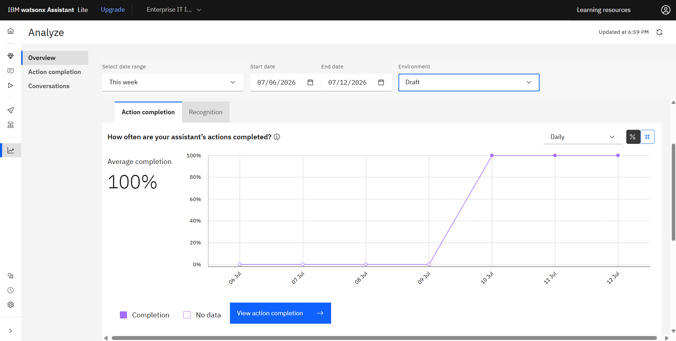
Token Usage
Conversational Analytics & Execution Metrics
100% Action Completion Rate: Proves that 100% of simulated IT incidents ($500$, $401$, and $404$ errors) successfully completed their routing paths and closed securely without getting stuck.
Zero-Token Static Orchestration: By utilizing watsonx Assistant’s native logic steps to process the routing, the system runs with zero token overhead for deterministic actions.
LLM Token Efficiency: The system only consumes model tokens when the underlying IBM Granite NLU engine needs to parse complex, unstructured user inputs to recognize a new error intent, dramatically saving GPU resources.

Slide 11
Novelty and Uniqueness
The proposed Automated DevOps & IT Incident Router Agent stands out by combining deterministic routing, platform-native Natural Language Understanding (NLU), and robust session isolation into a single intelligent system.
Multi-Branch Deterministic Intelligence – Instead of a generic static FAQ chatbot, multiple specialized logic branches ($500$, $401$, and $404$) process technical parameters to deliver exact engineering escalation targets.
Granite-Powered Intent Recognition – Integrates the underlying IBM Granite model series to translate unstructured, chaotic server alerts or human descriptions of system failures into precise, actionable intent categories.
Context-Aware Triage – Tailors incident severity levels based on specific response parameters, ensuring high-priority security breaches or database crashes bypass standard lines and reach the correct team instantly.
Deterministic Flow Optimization – Eliminates the high cost and latency of standard generative loops by handling core routing decisions via platform-level rules, invoking the LLM only for intent discovery.
Web Chat Standalone Integration – Features an enterprise-ready, customized dark-theme web widget designed for instant simulation and isolated staging environment deployments.
Operational Security & Isolation – Employs strict "End the action" states as a core architectural guardrail, completely eliminating conversation bleeding and safeguarding multi-tenant session security.
Scalable & Enterprise-Ready – Built natively within the IBM watsonx Assistant framework, ensuring bank-grade AI governance, compliance tracking, and reliable resource scaling.
This makes the solution a smart, highly secure, and proactive infrastructure gatekeeper, not just a static system-alert dashboard.

Slide 12
Git Hub Link:
https://github.com/Vibhu-18/Enterprise-IT-Incident-Routing-Automation

Slide 13
Future Scope:
Integration with Enterprise Monitoring Platforms & Webhooks – The system can be natively integrated with industry-standard observability tools like Prometheus, Grafana, Datadog, or PagerDuty using secure webhooks. This will enable the Incident Router Agent to automatically ingest real-time infrastructure telemetry, system logs, and automated server alerts, moving beyond manual user input to trigger instant, machine-to-machine DevOps triage.
Autonomous Remediation & AI-Powered Voice Escalation – Enhancing the system with automated script execution capabilities will allow the agent to not just route tickets, but proactively initiate basic recovery playbooks (such as restarting an isolated server pod or flushing an API gateway cache). Additionally, integrating voice-enabled outbound notification frameworks will allow the system to directly call on-call engineers during critical tier-1 outages, drastically reducing the enterprise Mean Time to Resolution (MTTR).

Slide 14
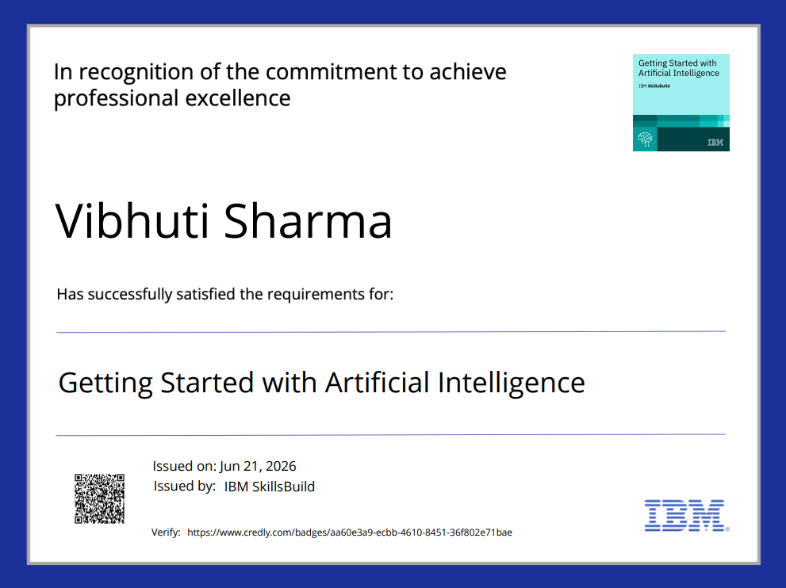
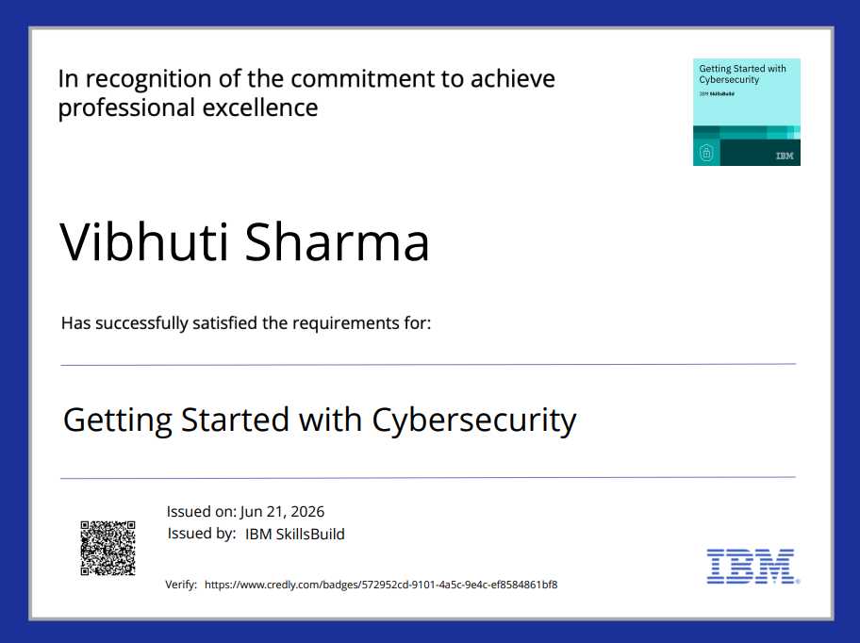
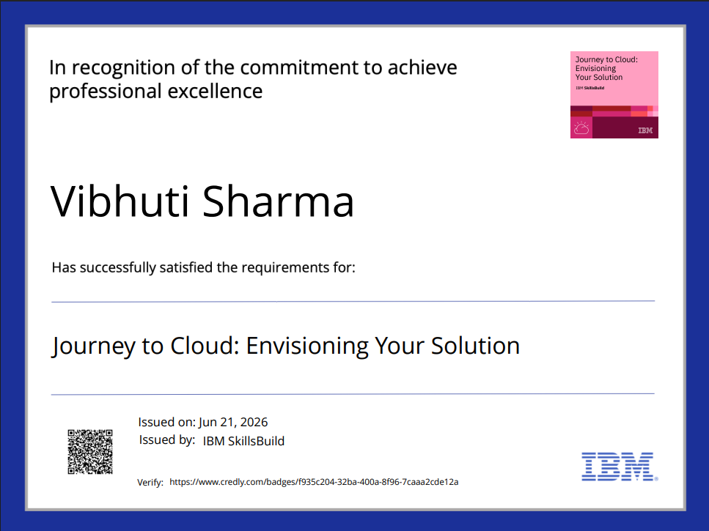
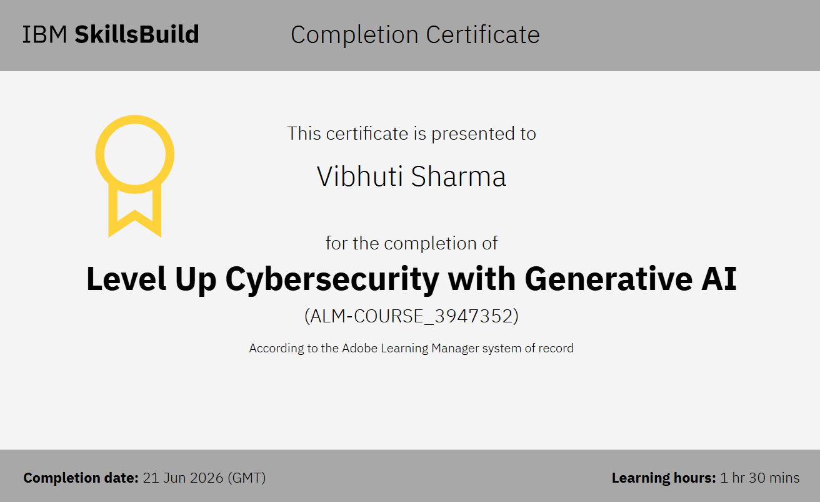
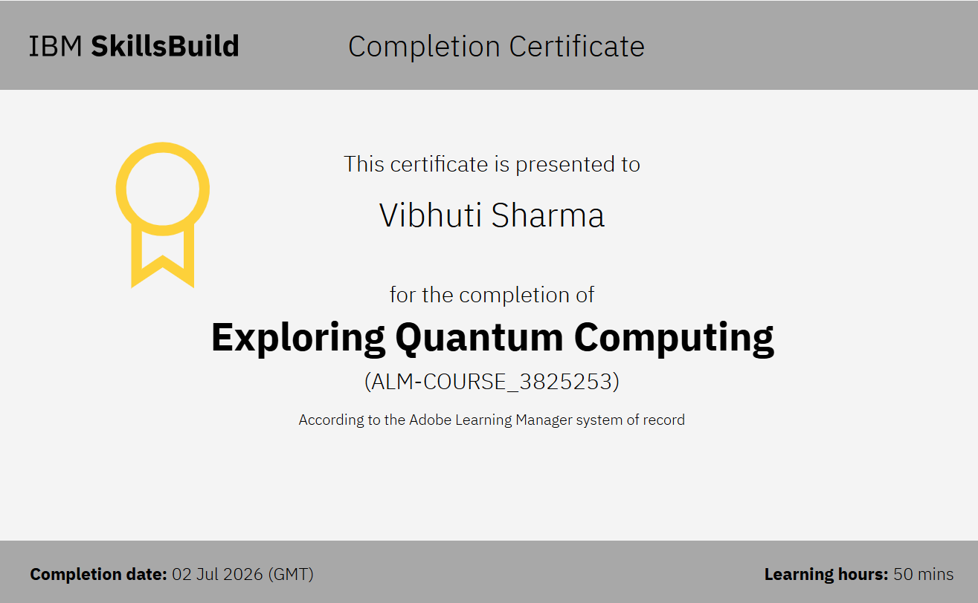
Certificates Earned:

Slide 15
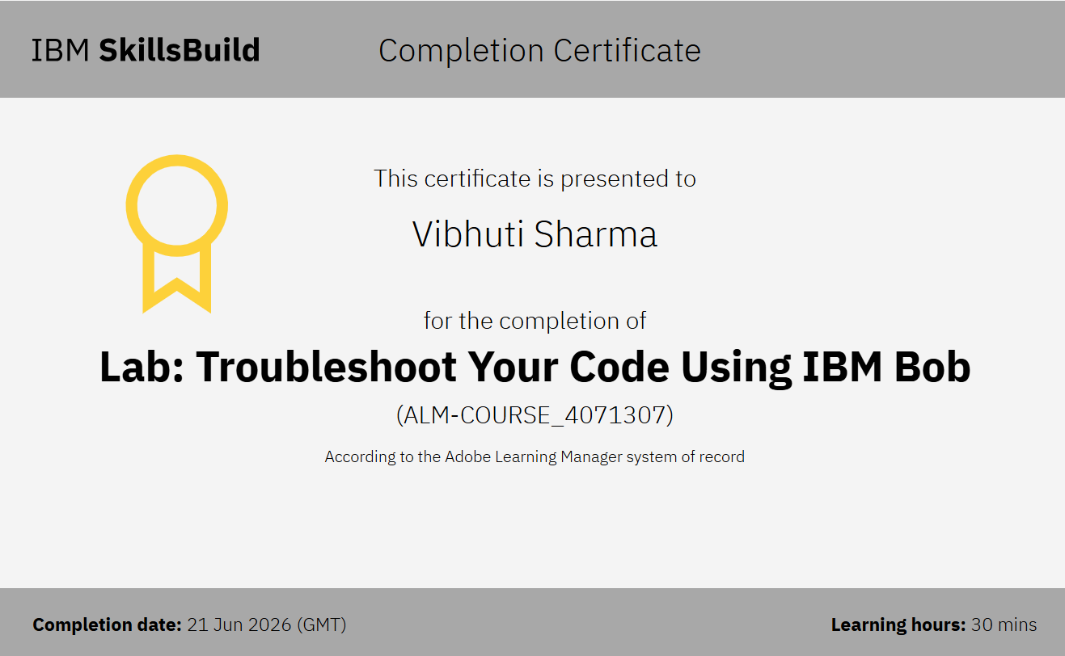
Certificates Earned:​ IBM BOB Certificate

Slide 16
THANK YOU !

